Slide 1
Developmental Psychology

Slide 2
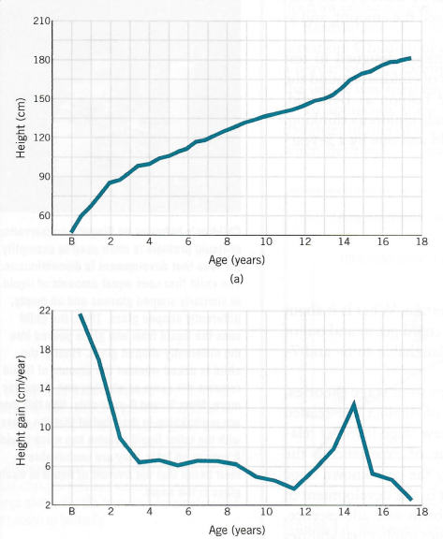
Developmental Psychology
Developmental psychology: examines how people develop physically, cognitively, and socially from infancy through old age.
Three main focuses:
Nature/ nurture
Stability/ change
Continuity/ stages

Slide 3
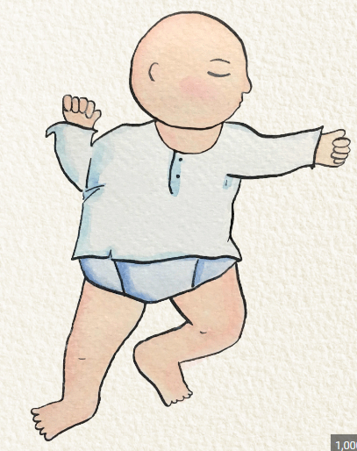
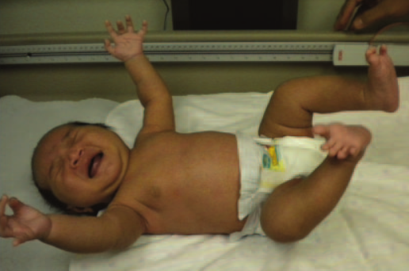
Infancy
Newborns have simple adaptive reflexes present at birth:
Rooting reflex
Tonic neck reflex
Palmar grasp reflex
Plantar reflex
Moro reflex

Slide 4
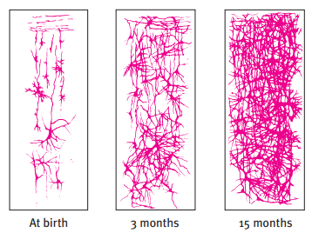
Infancy
Upon birth, have most the brain cells you will ever have.
Nervous system immature, neural networks become increasingly complex.
Neuroplasticity.

Slide 5
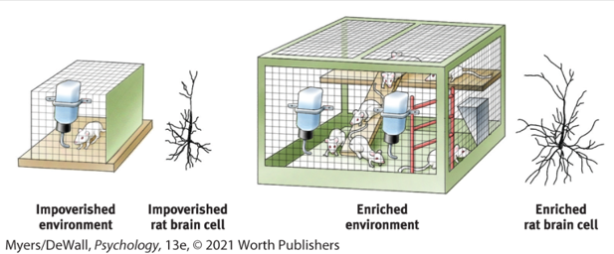
Infancy
Developmental accomplishments can have genetic components, but environment also matters.
Enriched environments linked to faster learning.
More feedback, attention, reinforcement.

Slide 6

Infancy
Newborns have preference for faces.
Born nearsighted and seeing mostly black and white.
Sight not good but hearing/ smell/ taste are well-developed.
Babies turn heads in direction of human voices.

Slide 7
Infancy
Infantile amnesia: inability of adults to recollect early memories.
An issue of memory, not of learning.
Young children do form long term memories, but forget them as they get older.
Rapid development of hippocampus (where explicit memory lives) in childhood leads to improved learning but also more rapid forgetting (interference).
Neglect or aversive experiences in childhood can impact adult behavior even if exact memory is not accessible.

Slide 8
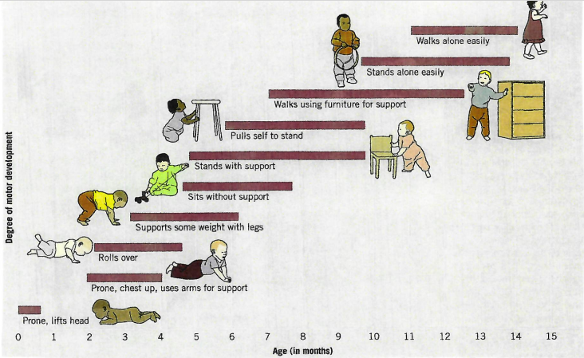
Infancy
Motor reflexes develop during critical periods.

Slide 9
Visual Cliff
Gibson & Walk (1960)
Evidence that human depth perception develops around 9 months of age.
Visual Cliff Experiment: OSU Psychology 1100.mp4 (youtube.com)

Slide 10
Infant Research: Methodology
Habituation: decreasing responsiveness with repeated stimulation.
As infants gain familiarity with repeated exposure, their interest wanes.
Faster habituation correlated with better executive function in later childhood (cognitive performance).
https://www.youtube.com/watch?v=dlilZh60qdA

Slide 11
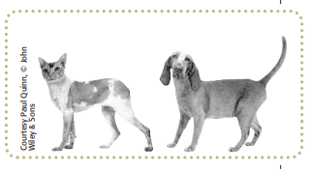
Infant Research: Methodology
Looking time studies
Violation of expectancy
https://www.youtube.com/watch?v=05pTztjg5jA

Slide 12
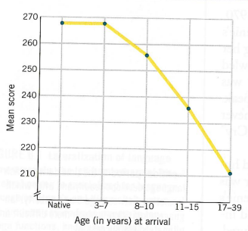
Stages of Language Development
Critical period hypothesis: time during which language develops readily.
Humans born with ability to master language.
Absent exposure to language before adolescence, a person will never master any language.
Babies will babble in different “languages” and respond differently to sounds from their native language.

Slide 13
Cognitive Development
Cognition: all mental activities associated with thinking, knowing, remembering, and communicating.
Piaget: stages of cognitive development.
Children of similar age made similar mistakes.
Maturing brains build schemas.
Schemas: concepts or framework that organizes and interprets information.
Assimilation and accommodation as complimentary processes that help children make sense of their world.

Slide 14
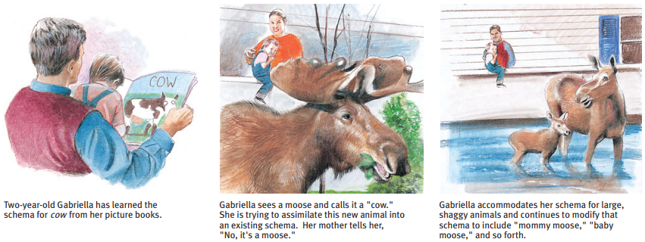
Cognitive Development
Assimilation: interpreting our new experience in terms of our existing schema.
Accommodation: adapting our current understandings to incorporate new information.

Slide 15
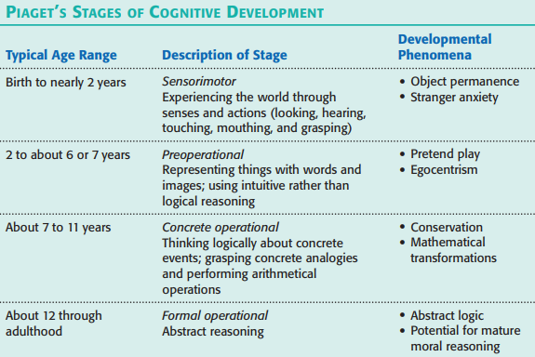

Slide 16
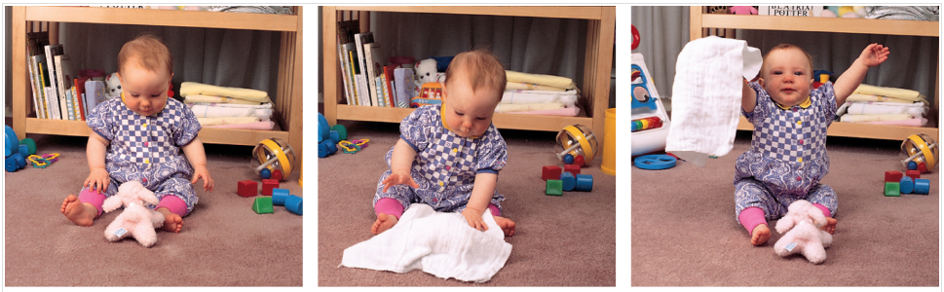
Sensorimotor Stage (birth - 2 years)
Lives in the present.
Thought and action virtually identical as child explores.
Learning occurs through use of hands and mouth.
No object permanence until 8 months.
A-not-B error: https://www.youtube.com/watch?v=4jW668F7HdA

Slide 17
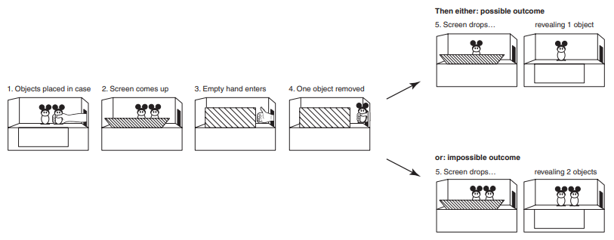
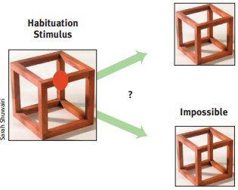

Slide 18
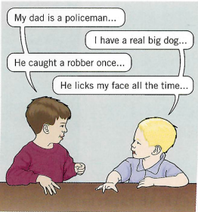
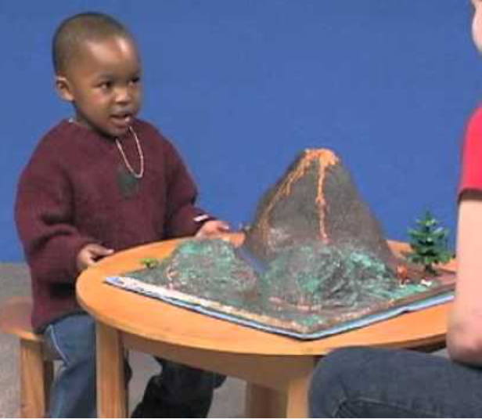
Preoperational Stage (2-7 years)
Symbolic representation.
Conservation: the principle that properties remain the same despite changes in the form.
A typical child on Piaget's conservation tasks – YouTube
Ego-centric: difficulty perspective-taking.
Perceptual impression chosen over logic.

Slide 19
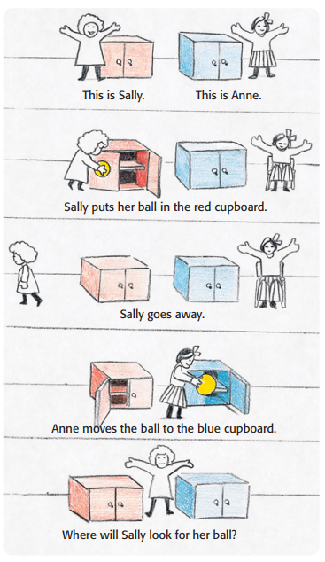
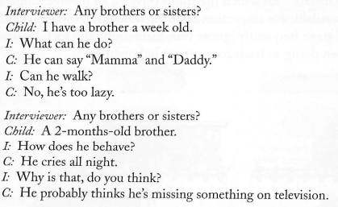
Preoperational Stage (2-7 years)
Theory of Mind
People’s ideas about their own and others’ mental states.

Slide 20
Concrete Operational Stage (7-11 years)
Conservation abilities develop.
Improved understanding of analogies, logic, mathematical concepts.
Thinking can be reversed and a sequence of changes can be held in the mind.
Awareness of other people’s viewpoints.
Appearance of systemic and logical reasoning.

Slide 21
Formal Operational (12+ years)
Can use analogies to understand concepts.
Independent, abstract thinking.
Can think about the future.
Ability to think about consequences.
Ability to reason systemically about possible outcomes: crucial for scientific reasoning.

Slide 22
Piaget: Pros and Cons
Pros
Identified significant cognitive milestones.
True across cultures.
Cons
Development is more continuous than Piaget thought.
Emphasis less on age and more on their sequence.
Milestones can require specific motor skills.
Needs more emphasis on interaction with the social environment rather than just the physical environment.

Slide 23
Social Development
Attachment: emotional tie with another person/ entity, usually a caregiver.
Stranger anxiety: fear of strangers that infants begin to display around 8 months old.
Critical period: period of extremely high sensitivity to stimuli from environment that shapes future social development.

Slide 24
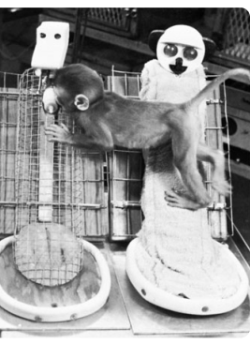
Social Development
Harlow et al. (1971)
Does attachment derive from association with nourishment?
Two artificial mothers.
Raised in isolation, babies missed important social skill development.
In humans, socially deprived children had lower cognitive ability scores, reduced brain development, abnormal stress responses.
Neglect and abuse became a cycle.

Slide 25
Social Development
Imprinting: the process by which certain animals form attachments during a critical period very early in life.
Duckling studies (Lorenz, 1937).
Hatching is critical period for ducklings.
First large moving object they see becomes imprinted as the mother.
Human children form attachments to people and things with which they are familiar.
Mere exposure can foster fondness.
Familiarity as a safety signal.

Slide 26
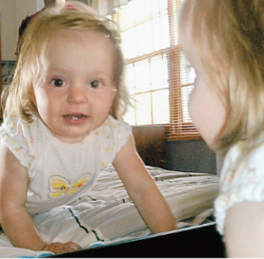
Self Concept
Self concept: our understanding and evaluation of who we are.
Begins around 15-18 months.
The Baby Human - Shopping Cart Study - YouTube
Group memberships
Psychological traits
Similarities and differences compared to other children.
Positive self concept associated with increased confidence, independence, optimism, assertiveness, sociability.

Slide 27
Adolescence
Transition period from childhood to adulthood.
Traits are not set in childhood, development is lifelong.
Adolescent brain vulnerable to:
Environmental stressors
Mental health problems
Impaired driving
Risky behavior
Drug addiction

Slide 28
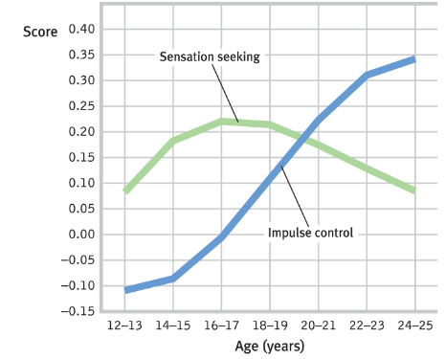
Adolescence
Prefrontal cortex
Development and maturation occurs primarily during adolescence.
Development not fully accomplished until about 25 years old.
Important for executive brain functions.
Prefrontal cortex responsible for:
Planning, prioritizing
Reasoning and judgment
Impulse control

Slide 29
Adolescence
Peer influence especially strong during childhood and adolescence.
Children will eat foods they dislike if sitting at a table with other children who like that food.
Children will adopt accent of their peers instead of their parents.
Adolescents seek out peers with similar attitudes, interests, and traits and adopt habits of their peers (e.g. smoking).

Slide 30
Moral Development
Heinz Dilemma
https://www.youtube.com/watch?v=ALE5H9Byms0
What should Heinz do?
Heinz should not steal the drug since he would be breaking the law.
Heinz should steal the drug and accept the punishment.
Heinz should steal the drug and not be punished.

Slide 31
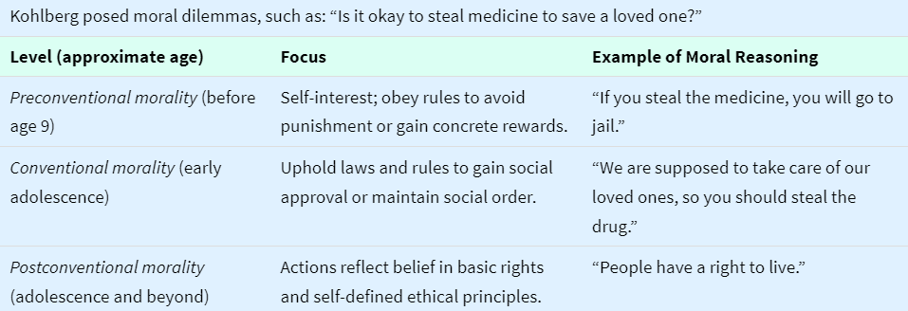
Kohlberg’s Levels of Moral Development

Slide 32
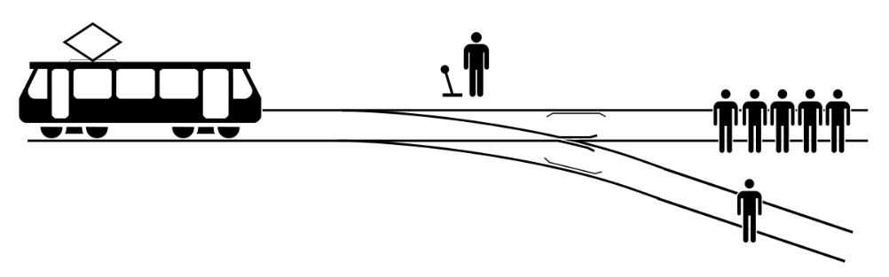
Moral Reasoning
The Trolley Problem
Magazine - Can Babies Tell Right From Wrong? | The New York Times – YouTube

Slide 33
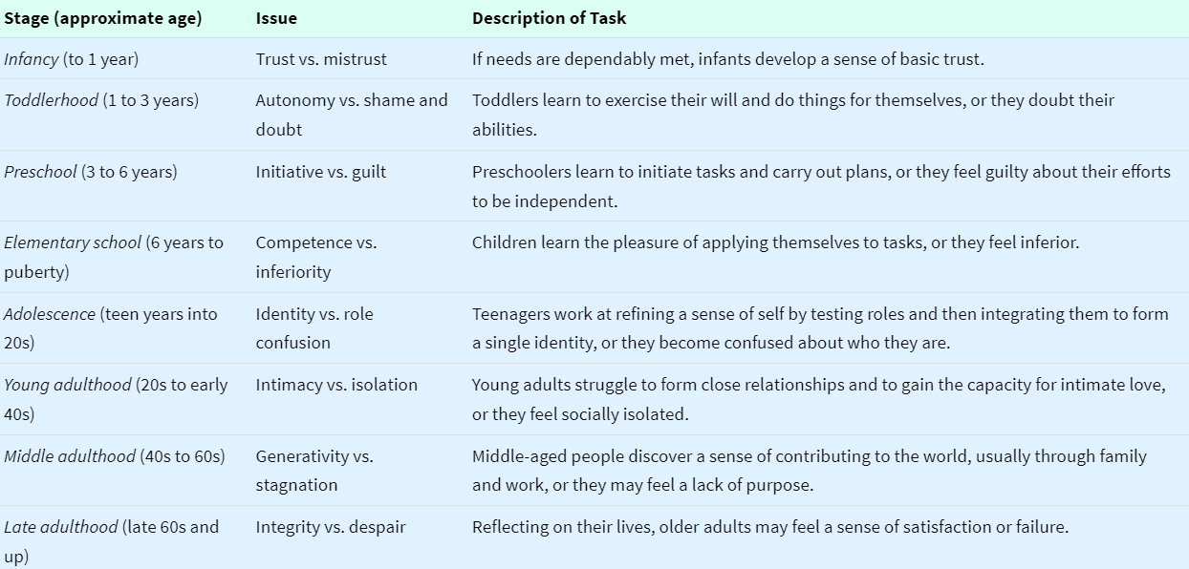
Erikson’s Psychosocial Stages of Development

Slide 34
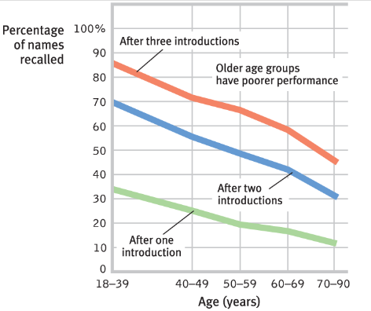
Aging
Sensory abilities diminish
Vision, hearing, muscle strength, stamina.
Neural processing slows
Reaction times, problem solving, memory.
Intelligence
Crystallized intelligence increases.
Fluid intelligence decreases.
Emotions
Increased expression of positive emotions.
Decreased attention to negative information.

Slide 35
Death & Grief
Kubler-Ross (1977) Five Stages of Grief
Denial
Bargaining
Anger
Depression
Acceptance

Slide 36
Ethical Behavior in Organizations
Ethics: the study of moral principles or values that determine whether actions are right or wrong and outcomes good or bad.
Moral intensity
Degree that issue demands ethical principles.
Ethical sensitivity
Ability to recognize the presence and determine the relative importance of an ethical issue.
Situational influences
Competitive pressures and other conditions that affect ethical behavior.

Slide 37
Supporting Ethical Behavior
Ethical code of conduct
Establishes standards of behavior.
Ethics training
Practice resolving ethical dilemmas.
Awareness and clarification of ethics code.
Ethical leadership and culture
Demonstrate integrity and model ethical conduct.

Slide 38
Ethics Dilemma Activity

